Slide 1


Supplier Payment Processing Assessment Workshop
14-Feb-2023

Slide 2
Agenda
1.0 Introduction Assessment Objective
2.0 Capability Deep Dive
3.0 Key Design Decisions
4.0 Integrations
5.0 Review Actions – (Question Responses)

Slide 3
Introduction

Slide 4
Section Objective
Procure To Pay
Duration | 1 hour
Objective | Provide an overview of functionalities, leading practice recommendations, and considerations related to Payable - Payment. Gather inputs to finalize solution, integration and conversion scope for the implementation of related capabilities
Key Activities | Process Overview Capability deep-dive Discuss confirmation questions Review key capabilities and leading practices Discuss data elements and key design decisions
What this is not | Design future state processes, finalize design decisions Gather Requirements Perform Fit-Gap analysis and solutions for business requirements

Slide 5
Payable : Procure to Pay
Track wise Process flows for Company X
Reporting
Level 1
Security and Controls (S&C)
Organizational Change Management (OCM)
Procure to Pay (PTP)
Acquire to Retire (ATR)
Record to Report (RTR)
Level 2
Manage Procurement
Manage Payables
Manage Fixed Assets
Manage Accounting and Control Data
Cash Management
Intercompany
Manage Contracts
Vendor setup
Perform Asset Additions
Maintain Enterprise Structure
Bank Statement Reconciliation
Generate Financial IC Transactions
Create Requisitions
Process Invoices
Adjust Assets
Maintain Chart of Accounts
Reconcile IC Accounts
Manage Purchase Orders
Employee Expense Reports
Transfer Assets
Maintain Currency & Rates
Process Receipts
Manage Payments
Retire Assets
Process Interfaced Journal Entries
Level 3
Vendor Onboarding
Process Manual Journal Entries
Period End Close
Reinstate Assets
Approve and Post JEs
Sourcing
Bank and Bank Branch Setup
Maintain Statutory and Tax Books
Process Reversing JEs
Maintenance Repair Operations (MRO)
Depreciation & Assets Period End Close
Process Recurring JEs
Short Term Maintenance
Perform Allocations
Perform Closing
(Period End)
Legend :
In Scope- L3 PTP Processes
L3 Processes- Other Tracks
Out of Scope
Financial Reporting

Slide 6
Procure To Pay (PTP)
ORACLE CLOUD PROCURE TO PAY OVERVIEW

Slide 7



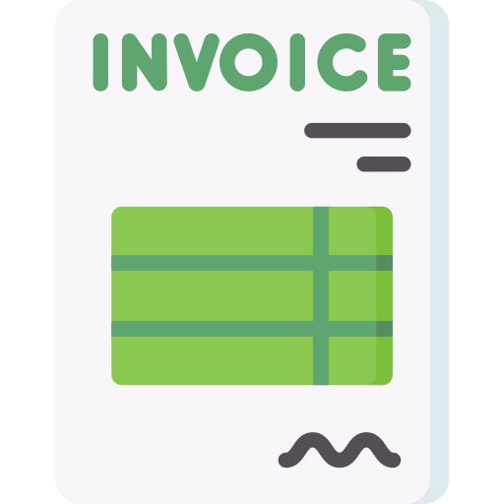




Description – Process Payments
Overview of Procure to Pay
Requisition : It is internal document to requesting the purchase of an item or service.
Purchase Order : It is an official document in which company commit to buy goods or services from supplier.
Receive Goods : Goods receipt is prepared at time of material received from supplier against purchase order.
Supplier : Supplier is party to whom purchase order issued and Goods and service received against that.
Invoice : An invoice is an itemized commercial document that records the products or services delivered to the customer, the total amount due, and the preferred payment method.
Payment : Depending on payment method in the invoice disbursement will be done either through bank transfers or check print or offline payments.
Reconciliation : Reconciliation of system payment entries with respective bank statement
Accounting & GL Posting : Create accounting executed to transfer data to GL module.
Requisition
Purchase Order
Supplier
Invoice
Disbursement
Reconciliation
Accounting & GL Posting
Receive Goods
Procurement
Payables
Payments
Cash Management
General Ledger
Notes:
In Company X as per existing process supplier invoice payment handle in SAP system and payment information update in oracle through automated process.

Slide 8
Procure To Pay - Payables
MANAGE PAYMENTS, BANK AND BANK BRANCHES

Slide 9
Manage Payments – Process Scope and overview
Supplier Invoice-Payment Lifecycle
Invoice Matched with PO
Invoice Validation and Approval
Payment Process
Payment Reconciliation
Payment Accounting
Once the invoice is received, it is created and matched 2-way or 3-way
Invoice is validated and routed to the approval.
Payment process is initiated for invoice on due date.
Payments are reconciled to bank statements
Accounting for payments is processed.
Leading Practices
Segregation Of Duties | Invoice entry, invoice approval and payment processing roles should be clearly segregated. Utilize standard job roles provided by cloud ERP to model the SOD structure.
Check Numbering | Maintain different ranges for numbering of payments across banks and formats for easy reference.
Pay Groups | Use pay group to classify invoices based on additional criteria. Assign pay group at supplier site level so that it would default automatically at invoice installment page. Use pay group in payment batch selection criteria to pay such grouped invoices.
Payment remittance | Include remittance information in EFT/ACH payment files sent to bank to be able to forward that to suppliers.
Payment Processing | Use of EFT/ACH payments is preferred over printed checks. Reduce effort by using Payment Process Request instead of manual payments.

Slide 10




Payment Processing
Single Payment
Payment Process Request
Payment types identify how a payment is recorded in Oracle Cloud Payables.
When you manage payments, you can search for payments by type. The focus is on automation and attempts to eliminate the redundancies of manual intervention in creation of a payment file.
Payment Types
PAYMENT PROCESS REQUESTS
QUICK
MANUAL
REFUND
Payments across multiple suppliers created by utilizing a selection criteria and automated processing functions.
A single payment for one or more invoices that's created without submitting a payment process request
A payment created outside of Payables and then recorded in Payables
A payment for a customer that closes an outstanding credit balance
Payment Process
Create Payment
Send Communication
Print Documents
Installment Selection
Payment Build
Payment Formatting
Create Payment Files
Document Validation
Generate Files
Payment Validation
Transfer Files

Slide 11
Manage Payments – Payment methods
Payment method is a way through which customers pay for invoice of product or service received from suppliers.
The payment method can be electronic, such as EFT or wire, or printed, such as a check. You can use a payment method to pay one or multiple third-party payees. Oracle Cloud Payments supports several payment methods including:
Payment methods | Description
Record Manual Payment | For payments made outside of Payables, for example, using a typed check or wire transfer, within Payables the payment can be recorded and updated in the invoices paid. Also use this method to pay invoices with the Clearing payment method. With a manual payment, you can override some payment controls of Payables.
Electronic Fund Transfer/EFT | A direct transfer of money from one account to another, such as electronic payment of an amount owed a supplier by transferring money from payer’s disbursement bank account into the supplier’s bank account.
Checks | To pay your suppliers, you can make payments by printing checks.
Key Design Decision
1. Payment methods
2. Integration with banks for supplier payment.
3. Process of Payment approvals.

Slide 12
Payments: Key Terminology
Key Terms for Oracle Payments are as below:
Payment Definitions of Key Terms | Leading Practice
Payment Process Request, PPR Template | Payment process request is a group of installments that is submitted for payment. For each payment process request specify selection criteria, payment attributes, processing options. The payment process request template is used to minimize data entry for frequently used payment processing settings.
Pay Groups | A pay group is used to categorize invoices on the basis of payments to be made in a group ex: Utility
Payment Method | Oracle Cloud supports several payment methods for funds disbursement, including Check, EFT/ACH, Wire. Custom methods can be defined as required.
Payment Process Profile | A payment process profile is a payment attribute assigned to documents payable, which specifies how Oracle Cloud performs processing. Payment process profiles are comprised of several types of payment processing information, including specifications for formatting and transmission. e.g., Check PPP & ACH PPP.
Formats | A customized layout for Checks and Electronic payments that adhere to the bank requirements. A check layout include all the check specification from bank along with the optional logo, and signatures based on business need.

Slide 13
Payments: Key Terminology
Key Terms for Oracle Payments are as below:
Payment Definitions of Key Terms | Leading Practice
Usage Rule | Usage rules defined at payment method level will help restricting the usage of the payment method to a specific legal entity, business unit, bank account etc.
Separate Remittance Advice | A predefined disbursement report that is sent electronically to suppliers, which lists the invoices your company paid.
Third Party Payments | A third-party payment is a payment that you make to a supplier on behalf of another supplier.
Positive Pay | A positive pay file is a predefined disbursement report, which acts as a security measure that your company can implement. The report prevents check fraud by informing your payment system or bank of issued payment documents and their amounts.
Manual | A payment created outside of Payables and then recorded in Payables.
Refund | A payment for a customer that closes an outstanding credit balance in AR

Slide 14
Manage Payments – Payable Payment Process
A payment process request is a group of installments submitted for payment.
You can submit a payment process request on the Submit Payment Process Request page. You can also create a template on the Create Payment Process Request Template page and schedule the template to submit the payment process request at a specified time each week/month and run as a background process. You can have multiple templates scheduled to run at different times with different selection criteria.
Payment methods | Description
Selection Criteria | Pay Group Payment Method Currencies Business Unit Legal Entities Source Supplier or Party
Payment and Processing Options | Payment Attributes Disbursement Bank Account Payment Document Payment Process Profile Payment Conversion Rate Types
Processing Options
Review Proposed Payments
Review Installments
Create Payment files Immediately

Slide 15
Demonstration
PAYMENTS

Slide 16
Bank and Bank Branch Setup
Company needs to define bank and bank branch setup to execute payment process.
Component | Description
Bank | Created as a party and needs information like country, bank name, address, etc. Bank data validation is done based on country specific requirements
Bank Branch | Once bank is created, the next step is creating a branch or branches associated to the bank. Needs information like bank, branch name, routing transit number/BIC code, address, contacts, etc.
Bank account | Under each branch the actual bank accounts are defined. Each bank account is associated to a Legal Entity. BUs associated to the legal entity are then provisioned access to use the bank account Payables need to be specified to determine for the purpose for use of the bank accounts. Accounts like Cash, Cash Clearing can be defined on the bank account.
Key Design Decision
Decision on bank and bank branch and accounts need to be created?
Leading Practices
Bank Bank Branch | Supplier bank accounts can be crated at the Supplier, Supplier Address, or Supplier Site Level. To simplify supplier bank account setups, make sure to include any supplier banks and branches when creating the bank accounts. This will prevent users from having to request and wait for these setups to be complete before adding supplier bank accounts.

Slide 17
Procure To Pay - Payables
PERIOD END CLOSE

Slide 18
Module in Scope and dependency for period end activity in Oracle
Payables
Procurement
Cost Management
Projects
Receivables
Fixed Assets
General Ledger
Legend
Module in Scope for period end
Order Management
Revenue Management
Module out of Scope for period end
Cash Management

Slide 19
Payable Period Close
Oracle prescribes a sequence for closing various sub-ledger periods. Subledgers must be closed before the General Ledger can be closed.
Import Payables Invoices
Complete, Approve & Account Invoices/ Payments
Transfer Accounting for invoices/payments to General Ledger
Sweep unaccounted transactions
Close current Payables Period
Open Next Payables Period
Key Design Decision
1. Month end process requirement.
Reconcile Payments
Reconcile Payables activity for the period
Leading Practice
Oracle prescribes a sequence for closing various sub-ledger periods. Subledgers must be closed before the General Ledger can be closed.
Close Payables before closing Procurement to take in to account the purchasing accruals at period end to accrue expenses on un-invoiced receipts.
Close Payables before closing Inventory to ensure the un-invoiced accrual entry is accurate.
Close Payables before closing Fixed Assets to ensure invoices are completed and capital invoice line distributions are transferred from Payables to Fixed Assets.
Close Procurement before closing Inventory to allow miscellaneous transaction corrections in Inventory. Close all subledger applications before closing General Ledger.

Slide 20
Procure To Pay - Payables
ORACLE CLOUD PAYABLE REPORTING

Slide 21
Out of Box Reports
Key Reports
No. | Report Name | Description
1 | Import Payables Invoices Report | Report from the process that creates Payables invoices from invoice data in the open interface tables.
2 | Payables Credit Memo Matching Report | Lists credit memos and debit memos for suppliers along with the invoices to which the credit memos and debit memos are matched.
3 | Payables Invoice Aging Report | Lists unpaid invoices according to the specified aging periods.
4 | Supplier Balance Aging Report | List the unpaid supplier invoices according to the specified aging periods.
5 | Payables Invoice Audit by Voucher Number Listing | Lists invoices with assigned sequential voucher numbers.
6 | Payables Invoice Audit Listing | Lists invoices for review and audit based on a specified amount for a given supplier and range of invoice creation dates.
7 | Payables Cash Requirement Report | Forecasts immediate cash needs for invoice payments.
8 | Payables Payment Requests Import Report | List the payment requests for invoices that are imported or rejected with rejection reasons for payments.
9 | Payables Discounts Taken and Lost Report | Identifies payments where a discount was taken and payments where a discount was available, but not taken.
10 | Payables Payment Register | Provides detailed information about payments

Slide 22
Review Action Items
Questions on current payment process
No | Action Item | Comment | Owner | Due Date
1 | What is the frequency of payment run ?
2 | What is the average volume of each payment being made through different payment methods (like Check, Cash, EFT, etc..) in a week/month?
3 | Are there any foreign currency payments (non-bank account currency) performed from your bank accounts?
4 | Are there any third-party payments that are currently being processed, i.e.., a payment that is made to a supplier on behalf of another supplier?
5 | How many different check formats are currently in use for payments?

Slide 23
Review Action Items
Questions on current payment process
No | Action Item | Comment | Owner | Due Date
6 | Are there any payments done directly on the bank portal, i.e., not part of the payment run?
7 | Are payments done by one entity on behalf of another?
8 | On payment completion are you sending remittance messages to suppliers with invoice details? If so, is the remittance advice content the same across all types of payments?
9 | What are the payment formats generated to load payment files to banks (apart from the Israeli Massad format)?
10 | Do we receive banks in standard formats (BAI2, SWIFT etc..) for all the banks?
11 | Do you send positive pay files to the bank for Check payments? If yes, how frequently these files are transmitted to the bank?

Slide 24
Conversion – Data Elements
Following table represents scope for master/transactional data conversions
No | Data element | Comment | Extraction Criteria (recommended)
1 | Supplier updates for payment and bank related information.
2
3
4
5
6
7

Slide 25
Key Integrations
Following table represents scope for integrations with edge applications as per current landscape
No | Integration | Source System | Target System
1 | Payment Data Outbound to TMS | Treasury Management System (TMS)
2 | Payment Data Outbound to DWH | Dataware House (DWH)
3 | Bank Statements inbound from BANK | BANK
4
5
6
7

Slide 26
Appendix

Slide 27
Payments: Key Features
Key Features for Oracle Payments are as below:
Features | Benefits
Manage Payment Process Requests | A payment process request is a group of invoices or invoice installments submitted for payments. Payment process request let business to specify Selection criteria such as invoice business unit, payment business unit, and payment priority determine which installments are selected for payment. Payment attributes like payment date, payment process profile. Processing options for a payment process request determine the level of automation for that request
Manage Payment Process Templates | Payment process template minimize the data entry for frequently used payment processing settings Identify cash requirements by running the Payables Cash Requirement report against the template Schedule payment process requests to run on a regular basis.
Manage Payment Validations | Payment validations are rules that ensure disbursements are correct before they are printed or transmitted to your bank or financial institution. Payment validations help find problems early in the payment process and decrease costs by preventing invalid data from reaching your bank.
Manage Payment Approvals | Payment approval process allows business to control payments by prioritizing invoices with available funds. On enabling payment approvals, payment process stops and lets approvers to review the payments, remove payment is required from payment process request and approve it.
Manage Positive Pay | Positive Pay is a predefined report sent by business to financial institutions with Payee name, currency, amount, etc. Positive Pay report prevents the payment of fraudulent checks, since unauthorized payments aren't listed on the Positive Pay report.
Send Remittance Advices | Remittance Advice report is a predefined disbursement report sent to suppliers on completion of payments.

Slide 28
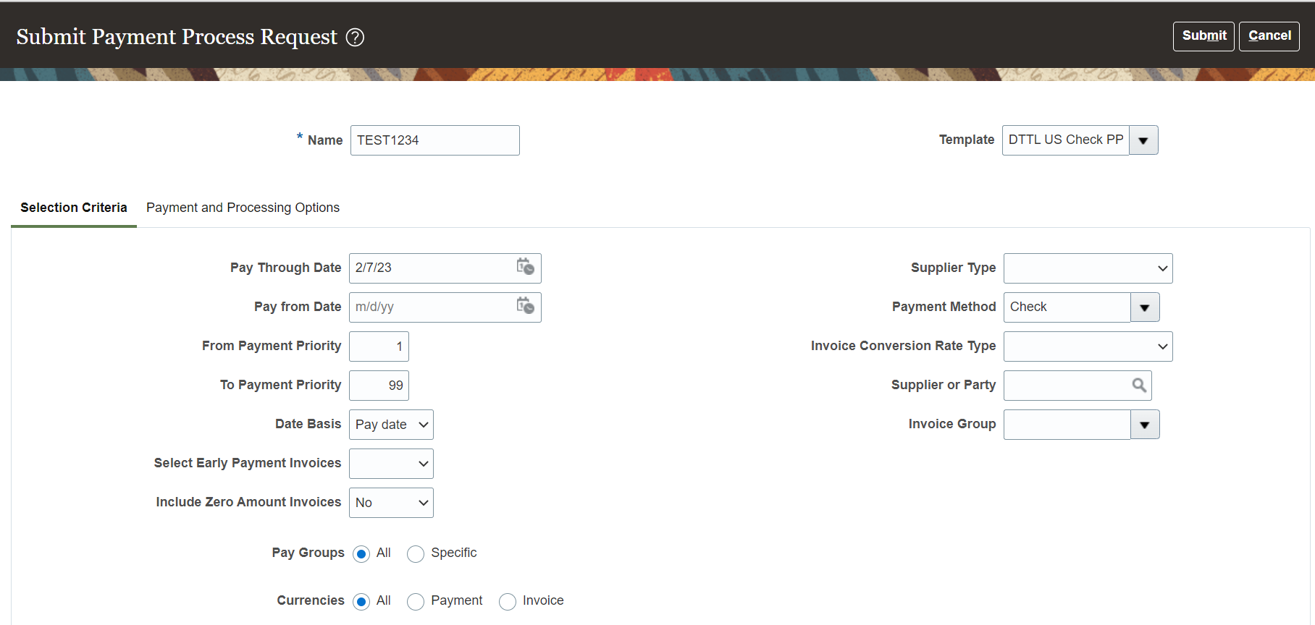

Payable Payment Process
System Demonstration – Create Payment by running payment process request – Selection criterion

Slide 29
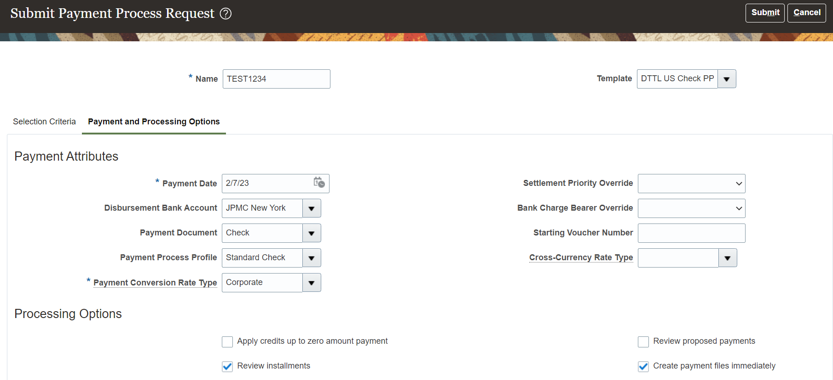
Payable Payment Process
System Demonstration – Create Payment by running payment process request – Payment and processing option

Slide 30
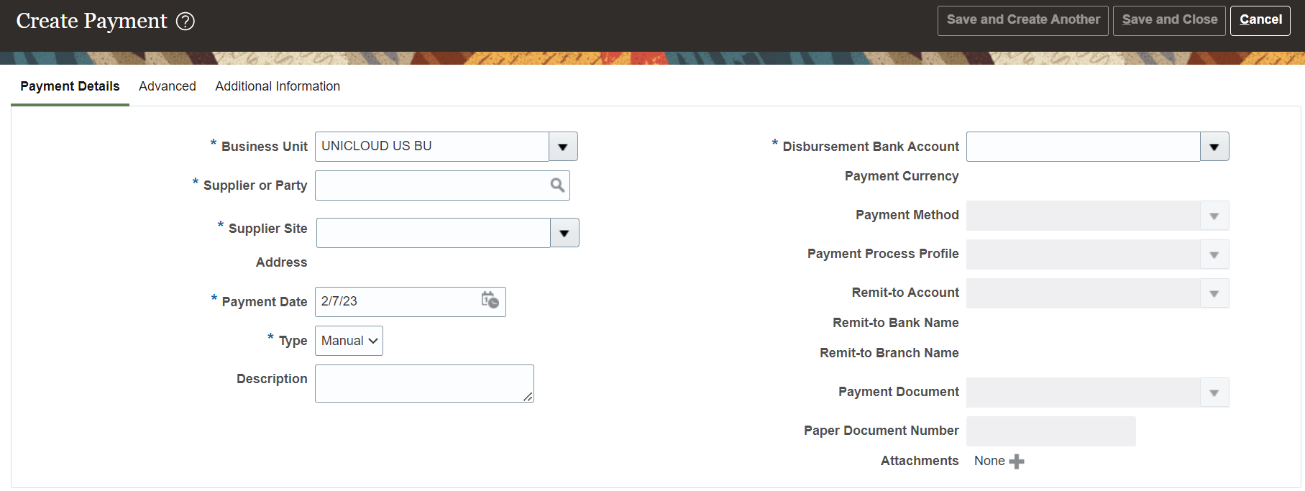
Payable Payment Process
System Demonstration – Create Manual Payment

Slide 31
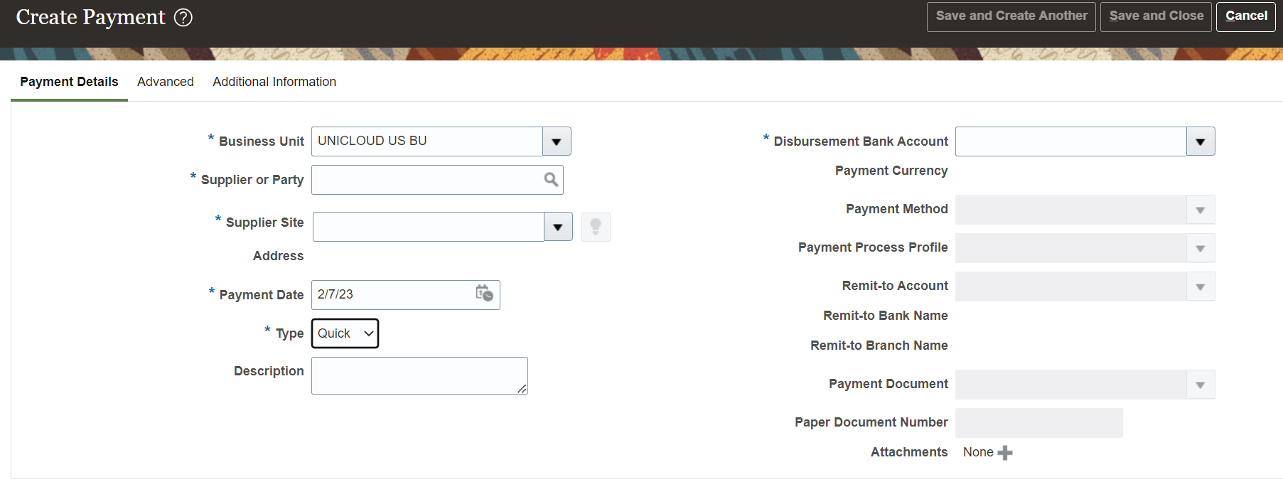
Payable Payment Process
System Demonstration – Create Quick Payment

